Slide 1
Gamification of Data
Group 1: Cameron Kozan, Ryan Ross, Zaid Alsafi, Alex Navarre

Slide 2
Project Description
Design a website that incorporates the concept of gamification that can help companies motivate and reward their employees for their good behaviors.
Invisi-tag is an asset management system which uses RFID tags to help businesses effortlessly keep track of their inventory.
Our job is to take the data from the Invisi-Tag system and provide companies with a platform that allows them to encourage employee engagement
Gamified Concepts:
Scores
Badges
Levels
Challenges

Slide 3
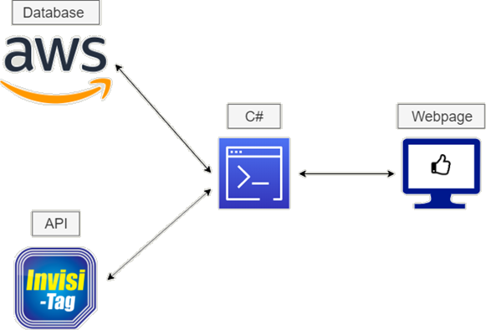
Project Overview

Slide 4
Prototype - Dashboard
Every time a user logs in, the default page will be the dashboard
The dashboard will have multiple tiles that display information about the user
The goal for our prototype was to:
Pull live data from the API
Use that data to calculate an employee’s score
Create a graph based on that individuals’ score
Fronted, Backend, and Database integration

Slide 5
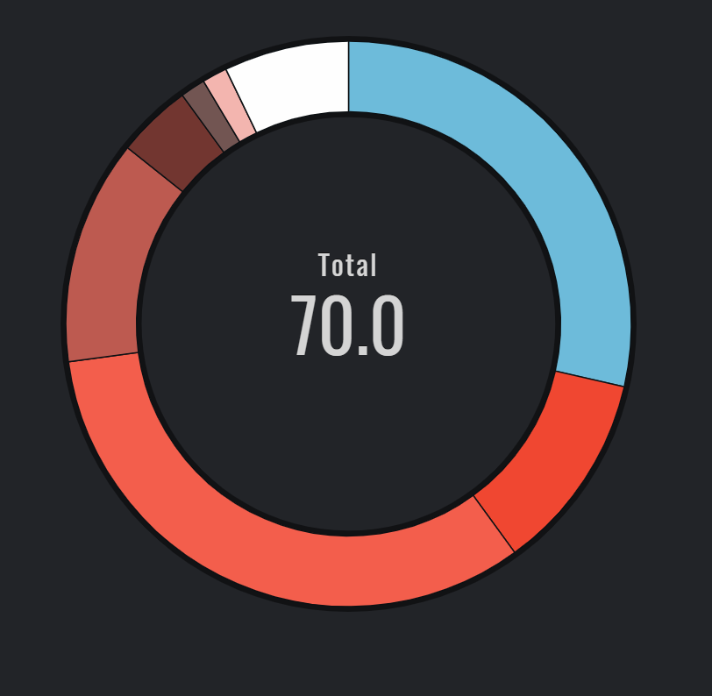
Prototype - Dashboard

Slide 6
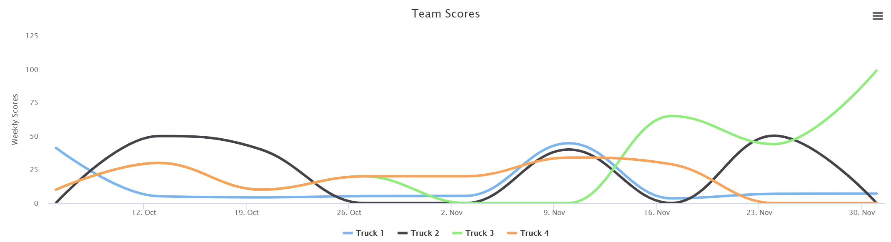
Prototype - Dashboard

Slide 7
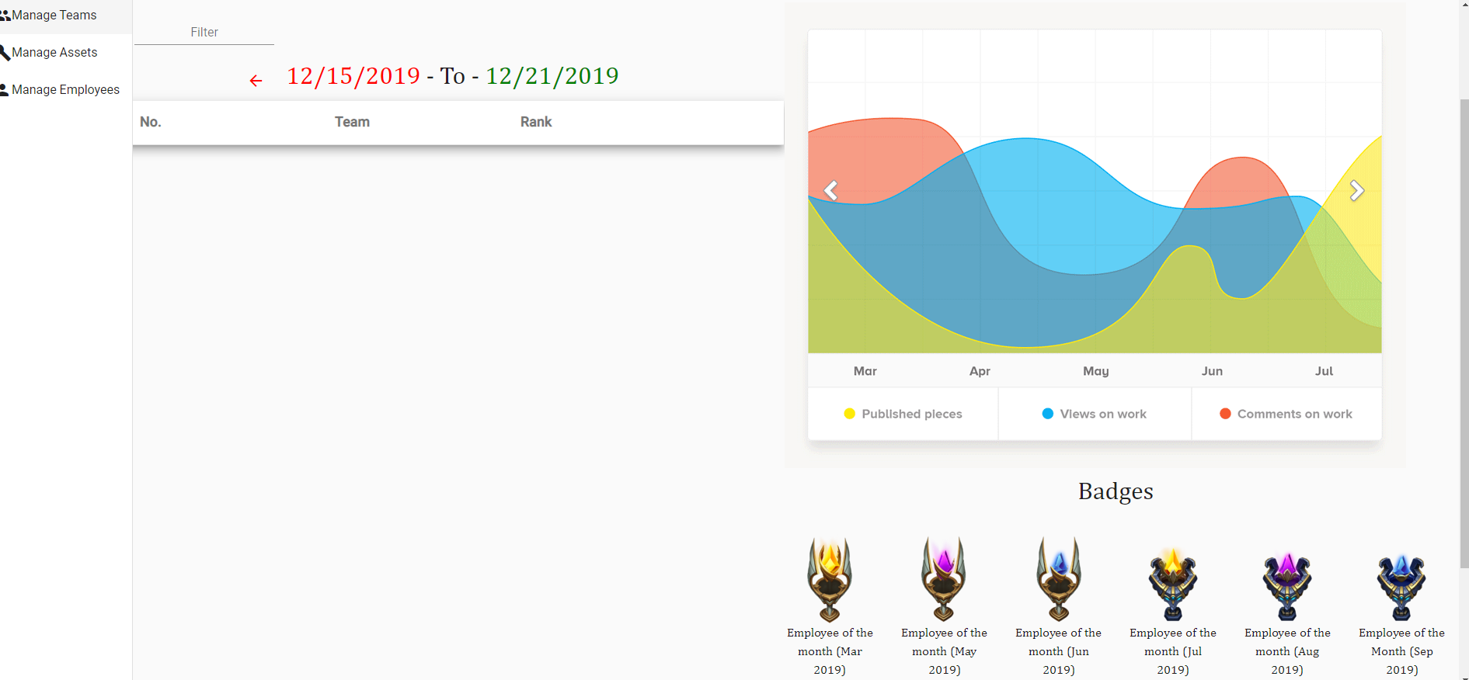
Prototype - Dashboard

